Slide 1

Submitted by: Sachin Sharma(2021a1r124) Shivam Dhar(2021a1r132) Preet Paul Sharma(2021a1r133) Superb Jain(2021a1r134) Ranbir Singh(2021a1r139)
Priority Scheduling Algorithms

Slide 2
Priority
Scheduling
Algorithms

Slide 3
Overview
Basic Concepts
Scheduling Criteria
Scheduling Algorithms
Example of Priority Scheduling
Advantages & Disadvantages

Slide 4
Basic Concepts
Main objective of multiprogramming is to keep on
running processes all the time for maximum CPU
utilization.
Scheduling is fundamental function of OS.
The task of selecting the processes in memory that are
ready to execute, and allocating them to the CPU is
performed by the CPU Scheduler.

Slide 5
CPU Scheduler
CPU scheduling decisions may take place when a process:
1. Switches from running to waiting state
2. Switches from running to ready state
3. Switches from waiting to ready
4. Terminates
Scheduling under 1 and 4 is non preemptive.
All other scheduling is preemptive.

Slide 6
CPU Scheduler
Non preemptive :
Once a process is allocated the CPU, it does not leave unless:
it has to wait, e.g., for 1/0 request
it terminates
• Preemptive :
OS can force (preempt) a process from CPU at anytime
E.g., to allocate CPU to another higher-priority process

Slide 7
Scheduling Criteria
CPU utilization: keep the CPU as busy as possible
Maximize
Throughput: No of processes that complete their
execution per time unit
Maximize
Turnaround time : amount of time to execute a
particular process (time from submission to termination).
Minimize

Slide 8
Scheduling Criteria
Waiting time: amount of time a process has been waiting in the ready
queue (sum of time waiting in ready queue ready queue).
Minimize
Response time — amount of time it takes from when submitted until the first response is a request was produced, output (for time-sharing environment)
Minimize

Slide 9
Scheduling Algorithms
• First Come, First Served
• Shortest Job First
• Priority
• Round Robin

Slide 10
Priority
A priority number (integer) is associated with each process.
Lager the CPU burst lower the priority.
The CPU is allocated to the process with the highest priority
(smallest integer = highest priority).
Starvation (Infinity blocking): low priority processes may never execute.
Aging : as time progresses increase the priority of the process.

Slide 11
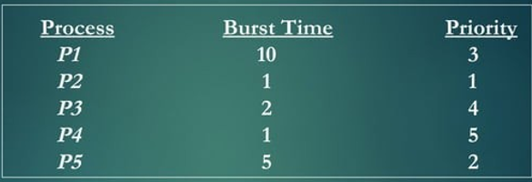
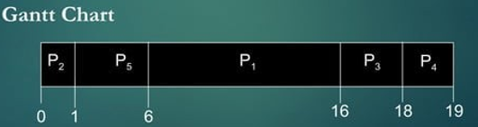

Example of Priority Scheduling (Non- Preemptive)

Slide 12
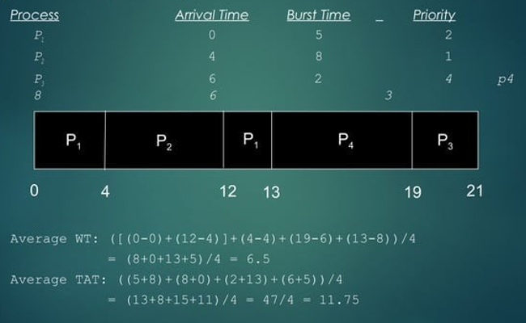
Example of Priority Scheduling (Preemptive)

Slide 13
Advantages of Priority
Easy to use
User friendly
Aging :- As time increases , increase in the priority of a process .
Simplicity .
Suitable for applications with varying time and resource requirement .

Slide 14
Disadvantages of Priority
If system eventually crashes , all low priority
processes get lost .
Indefinite blocking or Starvation .

Slide 15





